Slide 1
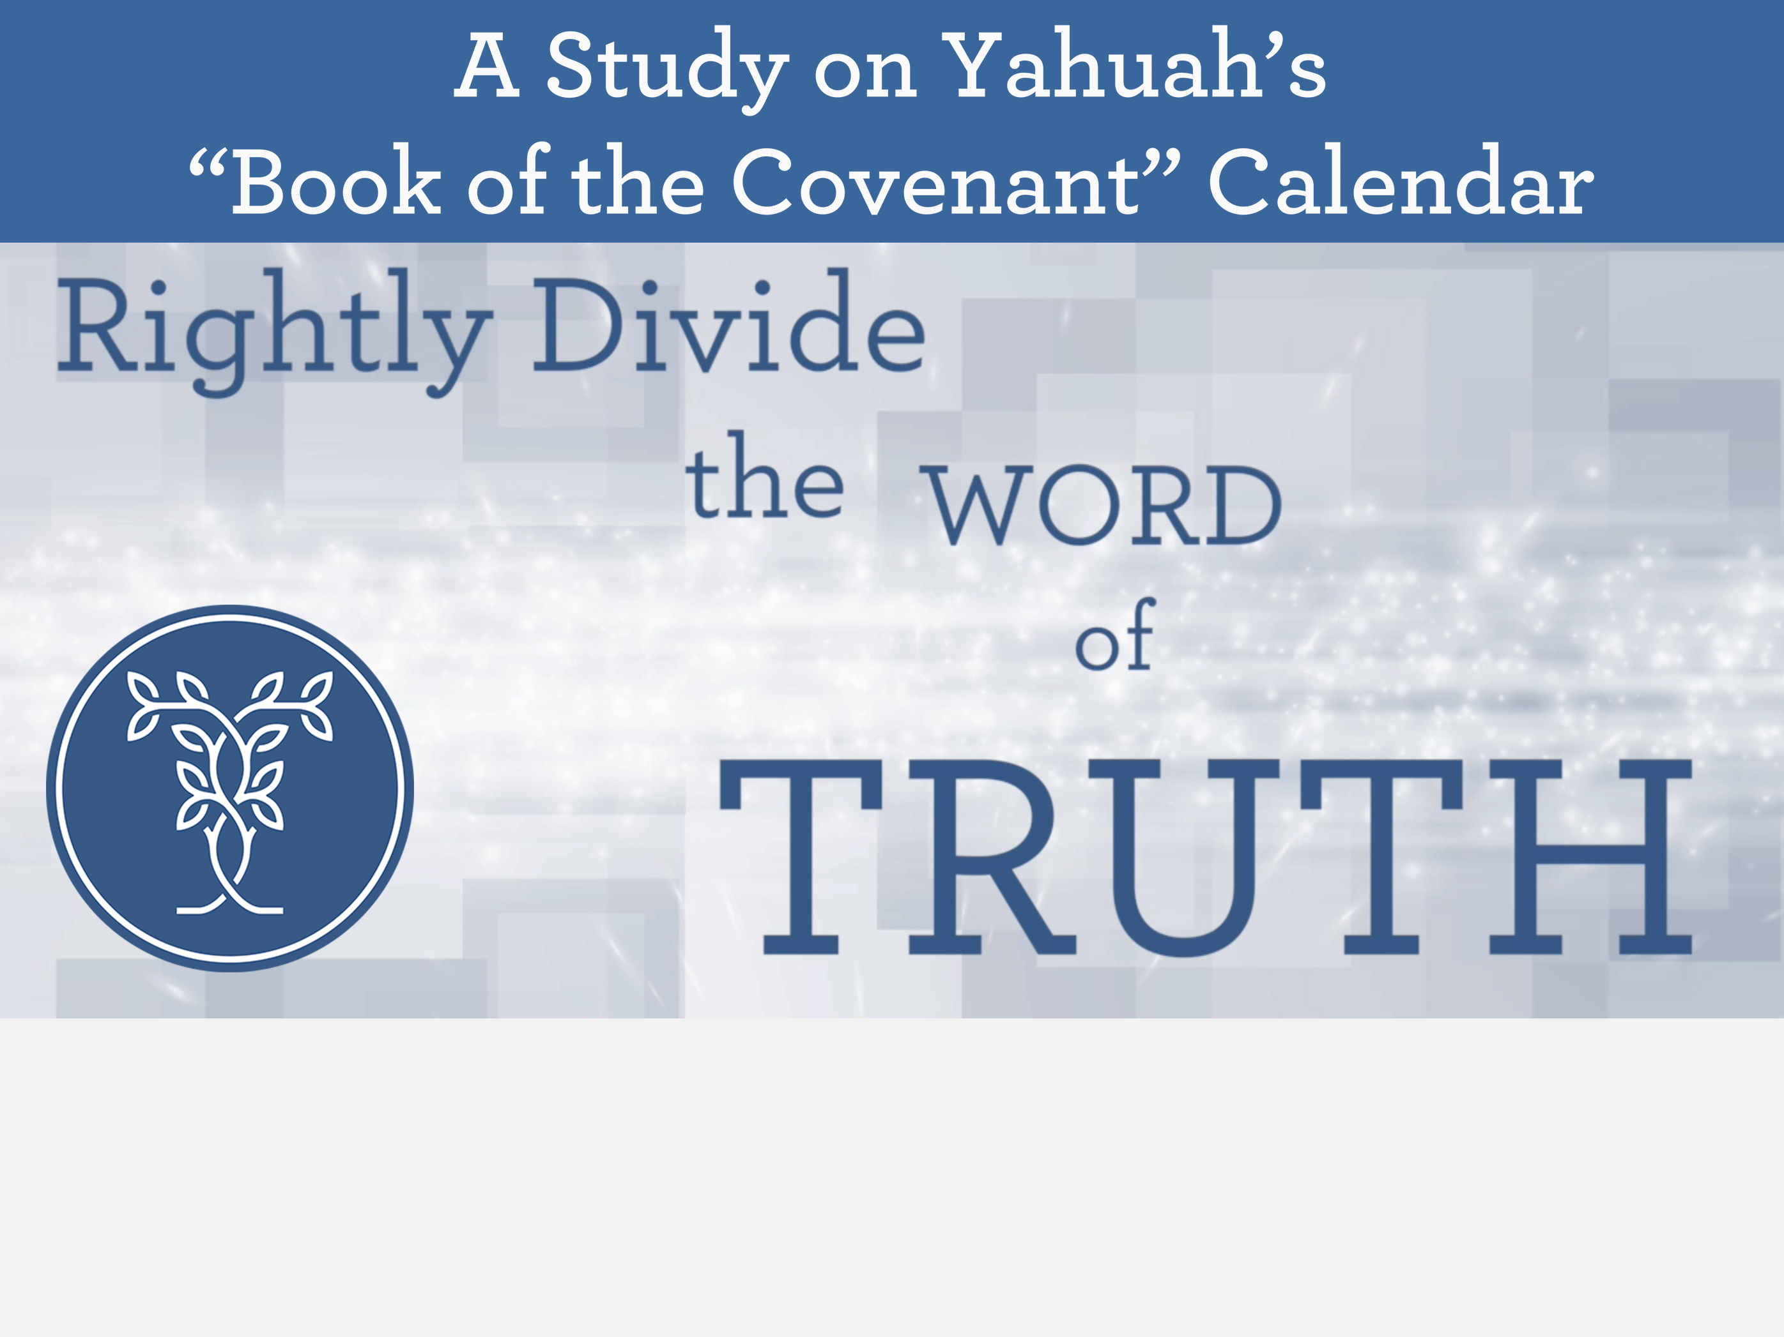
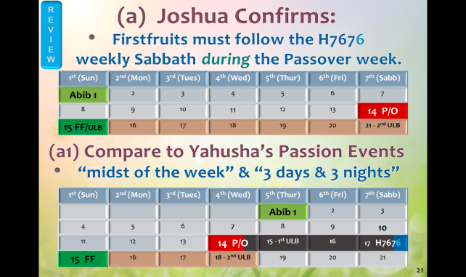
Sept 15/19: (I think this is the last PPT we used.)
See word document on Gap Theory that Tim and Charl responded to for April Carlson on the gap theory in vss 1 and 2 for H1961 (was) … as this is going to keep returning. I had sent her the PDF of slides 10-15 on my work around this Hebrew word number.
Nov 4/19 – huge error on slide 21 detected by Evelyn Nelson. Fix and replace on CCC website.
Review, Brand New & Q&A @
Calendar Conversation Class

Slide 2



Importance of Yahuah’s Calendar
The Scriptures speak of
THE Bridegroom and His Bride.
Certainly the Bride will know the Bridegroom’s calendar.
Yahuah’s Covenant Calendar marks out His divine worship statutes so His people can meet with Him on His designated time.

Slide 3
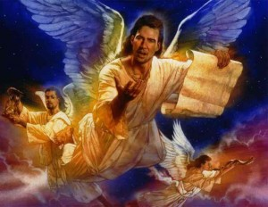
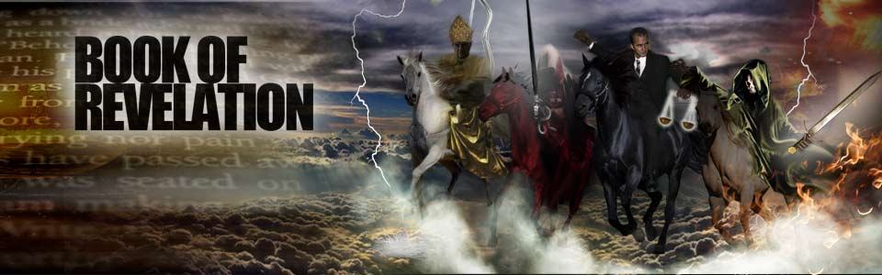
Yahuah’s Calendar: Another Mandate
Yahuah’s calendar will
also mark out prophetic end-time events so His people can know where they are in the stream of time as Revelation unfolds.
  Feasts & Festivals are strong
  markers in Revelation.

Slide 4



Is it False? or
Is it True?
Studying Yahuah’s Covenant Calendar will
also provide skills for the Bride to detect any
counterfeit calendars that offer challenges.
  There is no need to study counterfeit
  calendars. As these errors surface, they
  are automatically exposed by the true.
  Yahuah’s Covenant Calendar will always
  have the “last word” with plenty of witnesses.

Slide 5

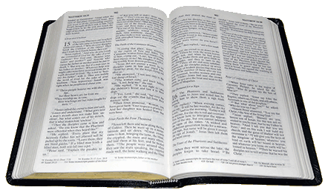

Remember:
Covenant Calendar is a riddle,
puzzle and secret (until revealed)!
We must pay attention to the
clues in calendar language!
Clues may be found in
unsuspected recorded events,
yet in highly interesting places.
Prov 25:2
It is the glory of [Yahuah] to conceal a thing: but the honour of kings is to search out a matter. KJV
Luke 8:17
For whatever is hidden shall be revealed, and whatever is secret shall be known and come to light. ISR (cf: Luke 12:2;
Matt 10:26; Mark 4:22)

Slide 6



Covenant Calendar Club [CCC]
Update for Each Student:
One of the regular CCC attendees made special mention to us about Gen 8:14, that seems to be lending
a huge clue to breaking open the calendar study even more.
This is a group study. As each of
you ponder this information your input is valuable and very welcome.
Let’s get started with this super interesting review, which one day
will be part of the full calendar study.

Slide 7

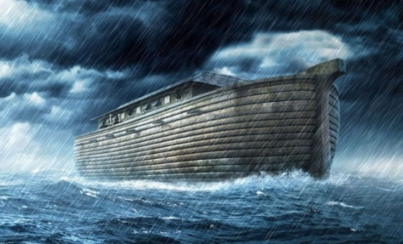

Question #1 About Noah:
Would Yahuah place calendar
clues in Noah’s flood account
for a special reason?
YEAR | MONTH | DAY | TEXT | COMMENT
1. 600TH | 2ND | 10TH | Gen 7:10 | Enter the Ark
2. 600TH | 2ND | 17TH | Gen 7:11 | Flood waters arrive
3. 600TH | 3RD | 27TH | Gen 7:17 | 40 days of rain
4. 600TH | (Month | Length) | Gen 7:24 Gen 8:3 | 5 months = 150 days
5. 600TH | 7th | 17th | Gen 8:4 | Ark rests on Ararat
6. 600TH | 10th | 1st | Gen 8:5 | Mountain tops are seen
7. 600TH | 11th | 10th | Gen 8:6 | Raven sent out
8. 600TH | 11th | 17th | Gen 8:10 | Dove sent out
9. 600TH | 11th | 24th | Gen 8:12 | Dove sent out again
10. 601ST | 1st | 1st | Gen 8:13 | Waters dried up
11. 601ST | 2nd | 27th | Gen 8:14 | Noah leaves ark
BRAND
NEW

Slide 8

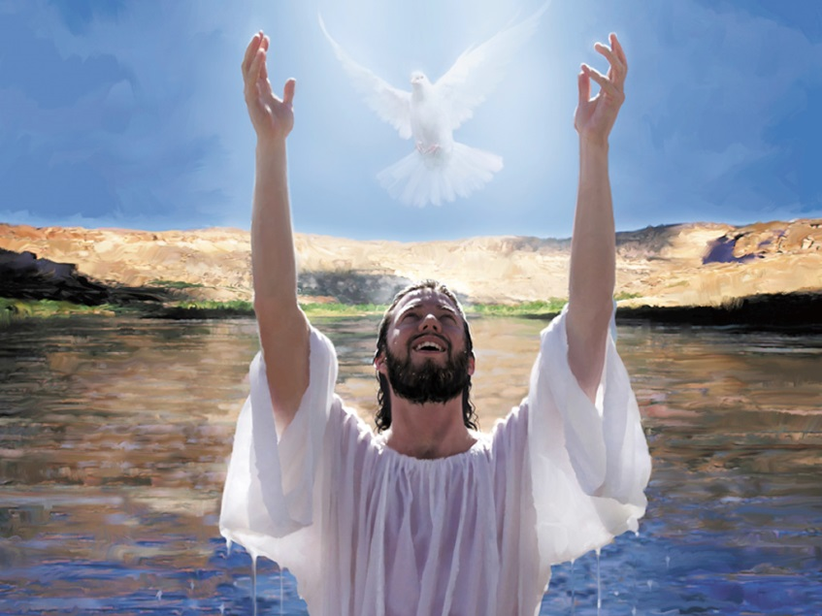
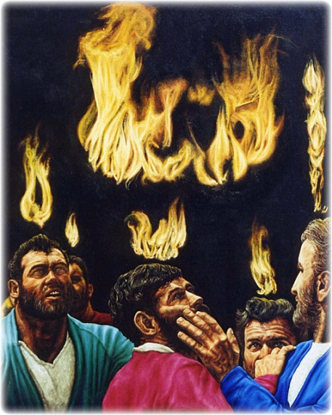
Question #2 About Yahusha:
Would Yahuah place calendar clues in
the Scriptures to allow the discovery
of Yahusha’s 70 week ministry, locking
down important dates?
From “water” … to “fire”
in 70 weeks?!
BRAND
NEW

Slide 9
Short Review & Brand New Material!
Gen 1:2 “… and the earth was H1961”
Comparison of Firstfruits placement between the true calendars of Moses
(Exo 12-19) Joshua, Yahusha & the
counterfeit calendars of Luni-Solar, & Enoch.
Lag Ba’Omer marries Firstfruits to
Abib 16th every year, with the
Omer count to 33 – a counterfeit.
Compare Lag Ba’Omer to the correct count for the 40th day of the Omer count as it connects to Gen 8:14 –
the “2nd month and 27th day.”
R
E
V
I
E
W
BRAND
NEW

Slide 10



One Announcement Before Going Further
BRAND
NEW
The following information is for your consideration only with a short investigation on the 1st usage of the word “was” [H1961] in Gen 1:2.
This section presents “an option”
for understanding why the translators of the KJV selected the
word “was” over other choices.
Everyone is responsible to continue their own research and massage their conclusions.
Examining ONE
Hermeneutic
Principle

Slide 11

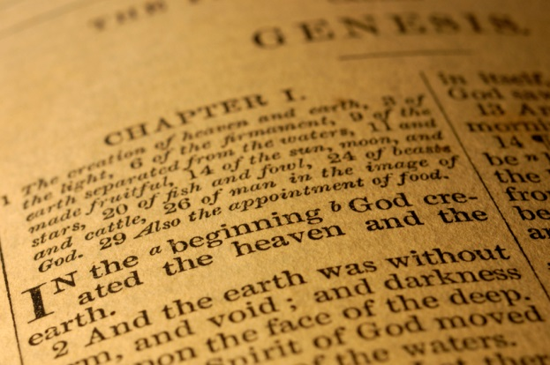
A Connection Between Sacred Name
& “was” (H1961) in Gen 1:2
Gen 1:2 is the first time the word “was” is used in Scripture.
The word “was” can cause
confusion for the proper understanding of the context.
The Hermeneutic principle of … “first word usage takes the first dictionary definition” does not seem to hold true for this word “was” this time.
Why does “was” have to take another definition to fit the
proper context of verse 2?
H1961 is “hayah”
BRAND
NEW

Slide 12
Is it possible H1961 has something
to do with the Sacred Name?
“was” (H1961) is “hayah”
BRAND
NEW
Matt 1:21 … thou shalt call his name JESUS (G2424) …
Iesous (ee-ay-sooce'); of Hebrew origin [H3091]; Jesus (i.e. Jehoshua), the name of our Lord [Master]…
H3091 Yehowshuwa` (yeh-ho-shoo'-ah); or Yehowshu` a (yeh-ho-shoo'-ah); from H3068 and H3467;
[Yahuah-saved] Jehovah-saved; Jehoshua (i.e. Joshua).
Yahusha (the Son) means
Yahuah-Saved.
Is it probable - a short
investigation of
Sacred Name will solve
the “was” confusion?

Slide 13
H3091 Yahusha from H3068 & H3467
H3068 points to Yahuah:
H3068 Yehovah (yeh-ho-vaw'); from H1961; (the) self-Existent or Eternal; Jehovah, Jewish national name of God [Elohim].
H3467 yasha` (yaw-shah');
a primitive root; properly,
to be open, wide or free, i.e.
(by implication) to be safe; causatively, to free or succor:
KJV - at all, avenging, defend, deliver (-er), help, preserve, rescue, be safe, bring (having) salvation, save (-iour), get victory.
H1961 hayah (haw-yaw);
a primitive root [compare H1933];
[1st def.] to exist,
[2nd def.] i.e. be or become,
[3rd def.] come to pass
H1933 hava' (haw-vaw'); or havah (haw-vaw'); a primitive root [compare H183, H1961] supposed to mean properly,
to breathe; to be (in the sense of existence): KJV - be, have.
BRAND
NEW

Slide 14
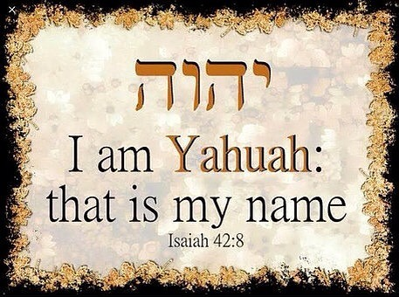
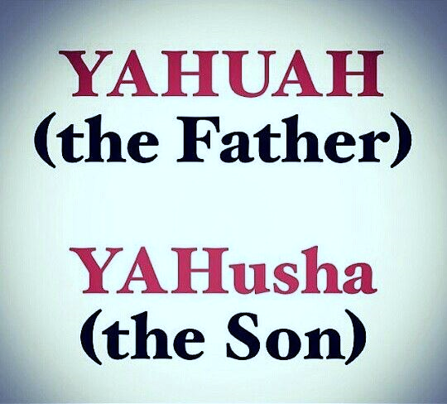
A Closer Look at H1961 [hayah]
H1961 hayah (haw-yaw); a primitive root
[Review: compare H1933 hava‘; supposed to mean properly,
to breathe; to be in the sense of existence]
Note: H1933 hava‘; meaning to breathe; or be in the sense of existence
appears to apply to the 1st two definitions for H1961 as listed below.
[1st def.] to exist
[2nd def.] i.e. be or become
John 1:18 … the only begotten Son,
which is in the bosom of the Father … KJV
Does it seem like the first two definitions of H1961 [hayah] link back to Gen 1:1, the Creator of heaven and earth?
BRAND
NEW

Slide 15





The 3rd Definition of H1961 [hayah]
H1961 hayah;
[3rd def.] come to pass; came to be
The 3rd definition is directly linked
to Gen 1:2 “And the earth came
to be without form, void, [with]
darkness upon the face of the
deep.”
BRAND
NEW
‘came
to be’ [hayah]
formless, void
& very dark.
Creation in Gen 1:1
The 3rd definition seems to align best with the context of Gen 1:2.

Slide 16
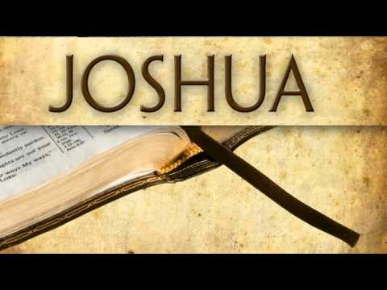
1. A Review of Firstfruits
2. A Review of Lag Ba’Omer

Slide 17


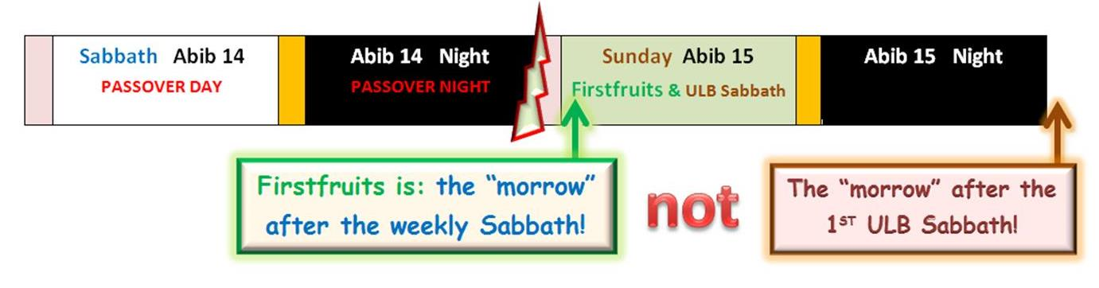
Joshua Confirms Firstfruits Follows the Passover Sabbath
R
E
V
I
E
W
The Wavesheaf of Firstfruits was waved on
Abib 15, the day after the weekly H7676 Sabbath!

Slide 18
Joshua Confirms Firstfruits follows only the H7676 weekly Sabbath – not the
1st Unleavened Bread Feast Sabbath!
Firstfruits never follows “days” linked
to the following Hebrew numbers:
H2282 – Feast [Chag]
H6944 – Holy [Qodesh]
H4744 – Convocation [miqra]
The 1st Sabbath of ULB on Abib 15
is always connected to
the Hebrew #s listed above.
R
E
V
I
E
W

Slide 19

Biblical Passover Placements:
Exodus 12 Passover on
3rd cycle (Tues)
Joshua Passover on
7th cycle (H7676 Sabbath)
Yahusha’s Passover on 4th cycle (Wed) the “midst of the week”!
Enoch has every Passover
celebration on the 3rd cycle
(Tues) of the week each year.
R
E
V
I
E
W

Slide 20
False Placements of Firstfruits
Joshua exposes:
The false teaching that Firstfruits must always be
celebrated on abib 16!
The false teaching that Firstfruits always follows
the 1st Unleavened Bread sabbath!
The false teaching of the Enoch Calendar that Firstfruits always follows the WEEKLY h7676 Sabbath OUTSIDE THE WEEK OF THE Passover festival!
Joshua sets the record straight.

Slide 21


(a) Joshua Confirms:
Firstfruits must follow the H7676
weekly Sabbath during the Passover week.
(a1) Compare to Yahusha’s Passion Events
“midst of the week” & “3 days & 3 nights”
R
E
V
I
E
W
1st (Sun) | 2nd (Mon) | 3rd (Tues) | 4th (Wed) | 5th (Thur) | 6th (Fri) | 7th (Sabb)
Abib 1 | 2 | 3 | 4 | 5 | 6 | 7
8 | 9 | 10 | 11 | 12 | 13 | 14 P/O
15 FF/ULB | 16 | 17 | 18 | 19 | 20 | 21 - 2nd ULB
1st (Sun) | 2nd (Mon) | 3rd (Tues) | 4th (Wed) | 5th (Thur) | 6th (Fri) | 7th (Sabb)
 |  |  |  | Abib 1 | 2 | 3
4 | 5 | 6 | 7 | 8 | 9 | 10
11 | 12 | 13 | 14 P/O | 15 - 1st ULB | 16 | 17 H7676
18 FF | 19 | 20 | 21- 2nd ULB | 22 | 23 | 24

Slide 22
(a) Joshua’s Calendar:
(b) Enoch’s Calendar teaches:
Firstfruits follows the weekly H7676 Sabbath outside of the Passover Festival week.
R
E
V
I
E
W
1st (Sun) | 2nd (Mon) | 3rd (Tues) | 4th (Wed) | 5th (Thur) | 6th (Fri) | 7th (Sabb)
Abib 1 | 2 | 3 | 4 | 5 | 6 | 7
8 | 9 | 10 | 11 | 12 | 13 | 14 P/O
15 FF/ULB | 16 | 17 | 18 | 19 | 20 | 21 – 2nd ULB
1st (Sun) | 2nd (Mon) | 3rd (Tues) | 4th (Wed) | 5th (Thur) | 6th (Fri) | 7th (Sabb)
 |  |  | Abib 1 | 2 | 3 | 4
5 | 6 | 7 | 8 | 9 | 10 | 11
12 | 13 | 14 P/O | 15 - 1st ULB | 16 | 17 | 18
19 | 20 | 21 – 2nd ULB | 22 | 23 | 24 | 25 H7676
26 FF | 27 | 28 | 29 | 30
Abib 26 Firstfruits placement definitely alters the Omer Count!

Slide 23

(a1) Yahusha’s Passion for Passover & Firstfruits
“midst of the week” & “3 days & 3 nights”
(b) Enoch’s Placement of Passover & Firstfruits
1st (Sun) | 2nd (Mon) | 3rd (Tues) | 4th (Wed) | 5th (Thur) | 6th (Fri) | 7th (Sabb)
 |  |  |  | Abib 1 | 2 | 3
4 | 5 | 6 | 7 | 8 | 9 | 10
11 | 12 | 13 | 14 P/O | 15 – 1st ULB | 16 | 17 H7676
18 FF | 19 | 20 | 21 - 2nd ULB | 22 | 23 | 24
1st (Sun) | 2nd (Mon) | 3rd (Tues) | 4th (Wed) | 5th (Thur) | 6th (Fri) | 7th (Sabb)
 |  |  | Abib 1 | 2 | 3 | 4
5 | 6 | 7 | 8 | 9 | 10 | 11
12 | 13 | 14 P/O | 15 - 1st ULB | 16 | 17 | 18
19 | 20 | 21 – 2nd ULB | 22 | 23 | 24 | 25 H7676
26 FF | 27 | 28 | 29 | 30
R
E
V
I
E
W
A 3rd cycle Passover does NOT fulfill “midst of the week.”
Firstfruits on Abib 26 does NOT fulfill Yahusha’s Wavesheaf!

Slide 24


#2 The Truth About …
Lag Ba’Omer marries Firstfruits to
Abib 16th every year, locking it to the
33rd day of the Omer count
[a counterfeit].
1st we’ll review the 2015 Christian Feast
calendar with Firstfruits on Abib 16.
2nd we’ll compare the Omer 33 count
and the Omer 40 count
to several other calendars.
R
E
V
I
E
W
BRAND
NEW

Slide 25
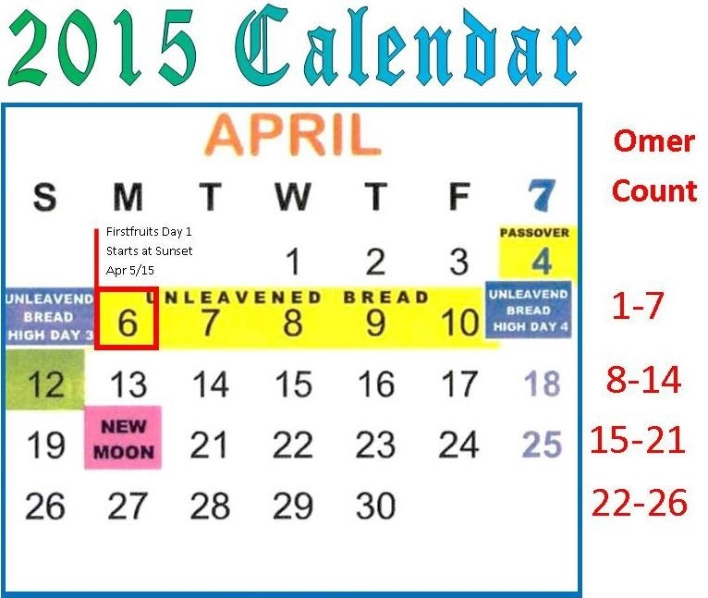
A Christian Calendar for Firstfruits
Question #1 was:
Will the following Christian Feast Calendar be the same as the traditional Jewish calendar for the 2015
Omer count?
Day One of the Omer Count begins at sunset on Sunday Apr 5th. Firstfruits is Monday Apr 6th.
Question #2 was: Will Day 33 of the Omer Count land on Thursday May 7, 2015 exactly like the Jewish calendar?

Slide 26
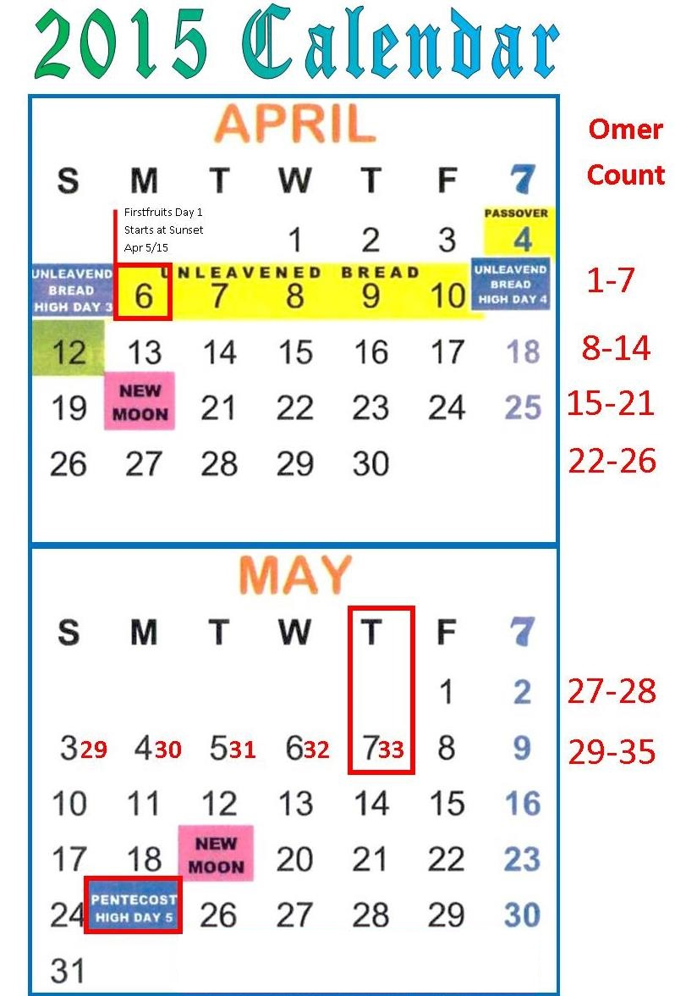

Answer:
Christian Feast Keepers that follow this Jewish calendar likely do not know the
33rd day of the Omer count pays respect to the death of the great mystic sage Rashbi, who authored the most famous book of the Kabbalah ushering in Jewish mysticism.
The Torah commands of Moses are very clear on the placement of Firstfruits “when Israel entered the land.” Joshua fulfilled those commands perfectly.
This Christian Feast
Calendar does favor the Jewish
Lag Ba’Omer
which begins at
sunset on May 6th!
May 7th is the 33rd day.

Slide 27
Remember: Zif 18 is the 33rd day
of the Omer count which is
always counted from Abib 16.
Next we’ll compare the Torah timing of Firstfruits in comparison to Lag Ba’Omer
on the following calendars:
Luni-Solar (Fri) Passover
Luni-Solar (Wed) Passover
Enoch’s (Tue) Passover
Moses’ (Tue) Passover
Joshua’s (Sabb) Passover
Yahusha’s (Wed) Passover
R
E
V
I
E
W
BRAND
NEW

Slide 28


What to watch for on each calendar:
We are looking specifically for the
40th day of the Omer Count
to see if it will place on the
27th day of the 2nd month!
(You’ll see why later.)
40th Day
of Omer
BRAND
NEW
2nd Mon;
27th Day

Slide 29

Luni-Solar: Fri Passover; Abib 16 Firstfruits
1st (Sun) | 2nd (Mon) | 3rd (Tues) | 4th (Wed) | 5th (Thur) | 6th (Fri) | 7th (Sabb)
 |  |  |  |  |  | Abib 1 | Omer
2 | 3 | 4 | 5 | 6 | 7 | 8 | Count
9 | 10 | 11 | 12 | 13 | 14 P/O | 15 1st ULB
16 - FF | 17 | 18 | 19 | 20 | 21 - 2nd ULB | 22 | 1-7
23 | 24 | 25 | 26 | 27 | 28 | 29 | 8-14
30 | Zif 1 | 2 | 3 | 4 | 5 | 6 | 15-21
7 | 8 | 9 | 10 | 11 | 12 | 13 | 22-28
14 | 15 | 16 | 17 | 18 - 33rd | 19 | 20 | 29-35
21 | 22 | 23 | 24 | 25 - 40th | 26 | 27 | 36-42
28 | 29 | 30 | Sivan 1 | 2 | 3 | 4 | 43-49
5 - 50th | 6 | 7 | 8 | 9 | 10 | 11 | 50
12 | 13 | 14 | 15 | 16 | 17 | 18
19 | 20 | 21 | 22 | 23 | 24 | 25
29 | 30 | 1 | 2 | 3 | 4 | 5
Remember: Lag Ba’Omer is always counted from Abib 16
The 40th Day of the Omer is not on the 2nd month 27th day!

Slide 30
Luni-Solar: Wed Passover; Abib 16 Firstfruits
1st (Sun) | 2nd (Mon) | 3rd (Tues) | 4th (Wed) | 5th (Thur) | 6th (Fri) | 7th (Sabb)
 |  |  |  | Abib 1 | 2 | 3 | Omer
4 | 5 | 6 | 7 | 8 | 9 | 10 | Count
11 | 12 | 13 | 14 - P/O | 15 - 1st ULB | 16 - FF | 17 - Sabb | 1-2
18 | 19 | 20 | 21 - 2nd ULB | 22 | 23 | 24 | 3-9
25 | 26 | 27 | 28 | 29 | 30 | Zif 1 | 10-16
Zif 2 | 3 | 4 | 5 | 6 | 7 | 8 | 17-23
9 | 10 | 11 | 12 | 13 | 14 | 15 | 24-30
16 | 17 | 18 - 33rd | 19 | 20 | 21 | 22 | 31-37
23 | 24 | 25 - 40th | 26 | 27 | 28 | 29 | 38-44
30 | Sivan 1 | 2 | 3 | 4 | 5 - 50th | 6 | 45-50
7 | 8 | 9 | 10 | 11 | 12 | 13
14 | 15 | 16 | 17 | 18 | 19 | 20
21 | 22 | 23 | 24 | 25 | 26 | 27
28 | 29 | 30
For a Wed Passover and a Sabbath resurrection, how can Firstfruits occur the day before the resurrection?
Lag Ba’Omer
The 40th Day of the Omer Count is not on the 2nd month 27th day!

Slide 31



Enoch: Tues Passover; Abib 26 Firstfruits
1st (Sun) | 2nd (Mon) | 3rd (Tues) | 4th (Wed) | 5th (Thur) | 6th (Fri) | 7th (Sabb)
 |  |  | Abib 1 | 2 | 3 | 4 | Omer
5 | 6 | 7 | 8 | 9 | 10 | 11 | Count
12 | 13 | 14 P/O | 15 - 1st ULB | 16 | 17 | 18
19 | 20 | 21 - 2nd ULB | 22 | 23 | 24 | 25 - Sabb
26 - FF | 27 | 28 | 29 | 30 | Zif 1 | 2 | 1-7
3 | 4 | 5 | 6 | 7 | 8 | 9 | 8-14
10 | 11 | 12 | 13 | 14 | 15 | 16 | 15-21
17 | 18 - 33rd | 19 | 20 | 21 | 22 | 23 | 22-28
24 | 25 | 26 | 27 | 28 | 29 | 30 | 29-35
Sivan 1 | 2 | 3 | 4 | 5 - 40th | 6 | 7 | 36-42
8 | 9 | 10 | 11 | 12 | 13 | 14 | 43-49
15 - 50th | 16 | 17 | 18 | 19 | 20 | 21 | 50
22 | 23 | 24 | 25 | 26 | 27 | 28
29 | 30 | 1 | 2 | 3 | 4 | 5
Firstfruits follows the Sabbath outside the Passover week.
Lag Ba’Omer
The 15th date of the 3rd month was ONE of the options for Pentecost from Ex 19:1.
The 40th Day of the Omer is not on the 2nd month 27th day!

Slide 32
MOSES: Tues Passover; Firstfruits after H7676
1st (Sun) | 2nd (Mon) | 3rd (Tues) | 4th (Wed) | 5th (Thur) | 6th (Fri) | 7th (Sabb)
 |  |  | Abib 1 | 2 | 3 | 4 | Omer
5 | 6 | 7 | 8 | 9 | 10 | 11 | Count
12 | 13 | 14 P/O | 15 - 1st ULB | 16 | 17 | 18 - H7676
19 - FF | 20 | 21 - 2nd ULB | 22 | 23 | 24 | 25 | 1-7
26 | 27 | 28 | 29 | 30 | Zif 1 | 2 | 8-14
3 | 4 | 5 | 6 | 7 | 8 | 9 | 15-21
10 | 11 | 12 | 13 | 14 | 15 | 16 | 22-28
17 | 18 - 33rd | 19 | 20 | 21 | 22 | 23 | 29-35
24 | 25 | 26 - 40th | 27 | 28 | 29 | 30 | 36-42
Sivan 1 | 2 | 3 | 4 | 5 | 6 | 7 | 43-49
8 - 50th | 9 | 10 | 11 | 12 | 13 | 14 | 50
15 | 16 | 17 | 18 | 19 | 20 | 21
22 | 23 | 24 | 25 | 26 | 27 | 28
29 | 30 | 1 | 2 | 3 | 4 | 5
Lag Ba’Omer
The 4th day of the 3rd month aligns with Exo 19:1 – the same day as exit from Egypt!
The 40th Day of the Omer is not on the 2nd month 27th day!

Slide 33
JOSHUA: Sabbath Passover; Firstfruits after H7676
1st (Sun) | 2nd (Mon) | 3rd (Tues) | 4th (Wed) | 5th (Thur) | 6th (Fri) | 7th (Sabb)
Abib 1 | 2 | 3 | 4 | 5 | 6 | 7 | Omer
8 | 9 | 10 | 11 | 12 | 13 | 14 P/O | Count
15 FF/ULB | 16 | 17 | 18 | 19 | 20 | 21 - 2nd ULB | 1-7
22 | 23 | 24 | 25 | 26 | 27 | 28 | 8-14
29 | 30 | Zif 1 | 2 | 3 | 4 | 5 | 15-21
6 | 7 | 8 | 9 | 10 | 11 | 12 | 22-28
13 | 14 | 15 | 16 | 17 | 18 - 33rd | 19 | 29-35
20 | 21 | 22 | 23 | 24 - 40th | 25 | 26 | 36-42
27 | 28 | 29 | 30 | Sivan 1 | 2 | 3 | 43-49
4 – 50th | 5 | 6 | 7 | 8 | 9 | 10 | 50
11 | 12 | 13 | 14 | 15 | 16 | 17
18 | 19 | 20 | 21 | 22 | 23 | 24
25 | 26 | 27 | 28 | 29 | 30
14th - H7676 Sabbath
Lag Ba’Omer
The 40th Day of the Omer is not on the 2nd month 27th day!

Slide 34

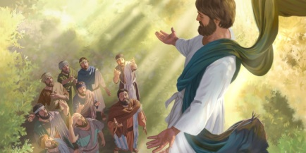
YAHUSHA: Wed Passover; Firstfruits after H7676
1st (Sun) | 2nd (Mon) | 3rd (Tues) | 4th (Wed) | 5th (Thur) | 6th (Fri) | 7th (Sabb)
 |  |  |  | Abib 1 | 2 | 3
4 | 5 | 6 | 7 | 8 | 9 | 10 | Omer
11 | 12 | 13 | 14 P/O | 15 - 1st ULB | 16 | 17-H7676 | Count
18 - FF | 19 | 20 | 21 - 2nd ULB | 22 | 23 | 24 | 1-7
25 | 26 | 27 | 28 | 29 | 30 | Zif 1 | 8-14
2 | 3 | 4 | 5 | 6 | 7 | 8 | 15-21
9 | 10 | 11 | 12 | 13 | 14 | 15 | 22-28
16 | 17 | 18 - 33rd | 19 | 20 | 21 | 22 | 29-35
23 | 24 | 25 | 26 | 27 - 40th | 28 | 29 | 36-42
30 | Sivan 1 | 2 | 3 | 4 | 5 | 6 | 43-49
7 - 50th | 8 | 9 | 10 | 11 | 12 | 13 | 50
14 | 15 | 16 | 17 | 18 | 19 | 20
21 | 22 | 23 | 24 | 25 | 26 | 27
29 | 30 | 1 | 2 | 3 | 4 | 5
This calendar houses the Wed Passover; Messianic timeline of 3 days & 3 nights; 1st ascension after the resurrection.
Lag Ba’Omer
BRAND
NEW
Yahusha’s Passover is the ONLY calendar where the 40th Day of the Omer count links to the 2nd month 27th day – pinpointing the ONE true Messiah!

Slide 35
YAHUSHA: Wed Passover; Firstfruits after H7676
1st (Sun) | 2nd (Mon) | 3rd (Tues) | 4th (Wed) | 5th (Thur) | 6th (Fri) | 7th (Sabb)
 |  |  |  | Abib 1 | 2 | 3
4 | 5 | 6 | 7 | 8 | 9 | 10 | Omer
11 | 12 | 13 | 14 P/O | 15 - 1st ULB | 16 | 17-Sabb | Count
18 - FF | 19 | 20 | 21 - 2nd ULB | 22 | 23 | 24 | 1-7
25 | 26 | 27 | 28 | 29 | 30 | Zif 1 | 8-14
2 | 3 | 4 | 5 | 6 | 7 | 8 | 15-21
9 | 10 | 11 | 12 | 13 | 14 | 15 | 22-28
16 | 17 | 18 - 33rd | 19 | 20 | 21 | 22 | 29-35
23 | 24 | 25 | 26 | 27 - 40th | 28 | 29 | 36-42
30 | Sivan 1 | 2 | 3 | 4 | 5 | 6 | 43-49
7 - 50th | 8 | 9 | 10 | 11 | 12 | 13 | 50
14 | 15 | 16 | 17 | 18 | 19 | 20
21 | 22 | 23 | 24 | 25 | 26 | 27
29 | 30 | 1 | 2 | 3 | 4 | 5
BRAND NEW
This is the ONLY calendar that can satisfy ALL these requirements: 1) 4th cycle cross; 2) 3 days & 3 nights;
3) Sabbath resurrection; 4) 1st cycle Wavesheaf and;
5) houses the 40th day of the Omer count on the 27th day of the 2nd month – the day of Yahusha’s 2nd ascension.
Why is the placement of this 40th day so important?

Slide 36
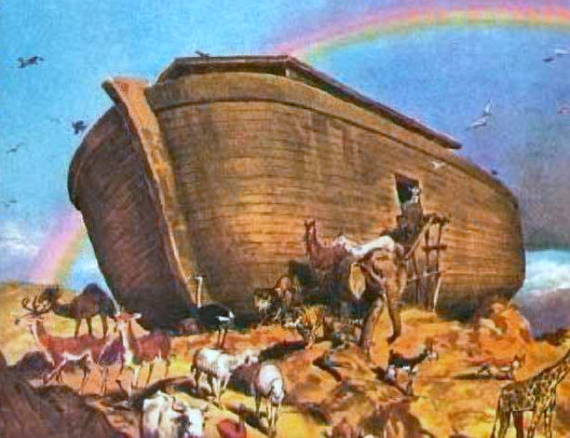
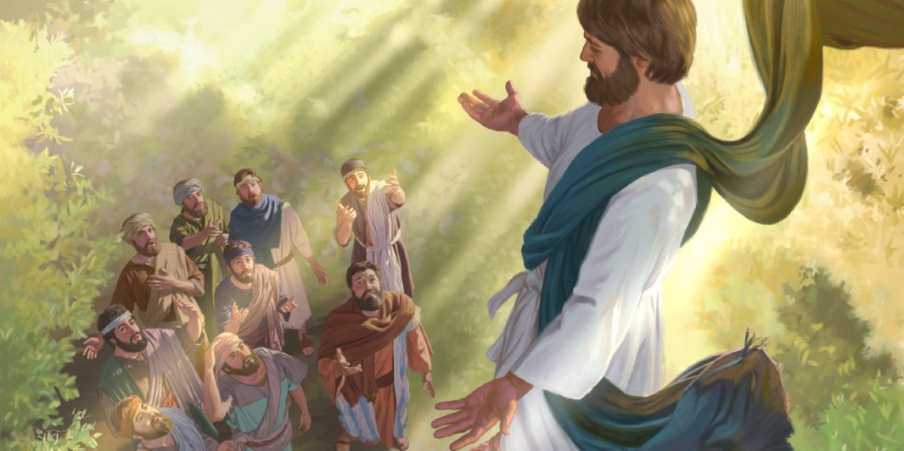
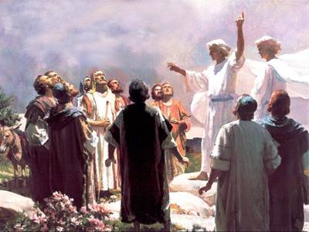
Gen 8:14-16 And in the second month, on the seven and twentieth day of the month, was the earth dried.
15 And [Yahuah] spake unto Noah, saying, 16 Go forth of the ark … KJV
Noah left the ark!
What’s so special about the 27th day
of the 2nd month in Yahusha’s 2nd year?
Acts 1:9-11 … while they beheld, he was taken up; and a cloud received him out of their sight.
10 And while they looked stedfastly toward heaven as he went up, behold, two men stood by them in white apparel; 11 Which also said, Ye men of Galilee, why stand ye gazing up into heaven? this same Jesus, which is taken up from you into heaven, shall so come in like manner as ye have seen him go into heaven. KJV
BRAND
NEW
Yahusha left the earth!
The prophecy of the ascension on the 40th day of the Omer count is given through Noah!

Slide 37
Remember This Question About Noah?
Would Yahuah place calendar clues in
Noah’s flood account with alignment
to Yahusha ?
2300 years before the cross
YEAR | MONTH | DAY | TEXT | COMMENT
1. 600TH | 2ND | 10TH | Gen 7:10 | Enter the Ark
2. 600TH | 2ND | 17TH | Gen 7:11 | Flood waters arrive
3. 600TH | 3RD | 27TH | Gen 7:17 | 40 days of rain
4. 600TH | (Month | Length) | Gen 7:24 Gen 8:3 | 5 months = 150 days
5. 600TH | 7th | 17th | Gen 8:4 | Ark rests on Ararat
6. 600TH | 10th | 1st | Gen 8:5 | Mountain tops are seen
7. 600TH | 11th | 10th | Gen 8:6 | Raven sent out
8. 600TH | 11th | 17th | Gen 8:10 | Dove sent out
9. 600TH | 11th | 24th | Gen 8:12 | Dove sent out again
10. 601ST | 1st | 1st | Gen 8:13 | Waters dried up
11. 601ST | 2nd | 27th | Gen 8:14 | Noah leaves ark
BRAND
NEW

Slide 38




Something Sweet to Think About
Are there clues
in Noah’s flood account
that will assist Yahuah’s people to verify His
Covenant Calendar?

Slide 39


Consider these 2 Dates in
Calendar Construction
Will Yahusha’s Passover in “the midst of the week” and His ascension on the 40th day of the Omer Count be the two golden keys to rebuild the
Covenant Calendar for His full ministry?
Abib 14
Zif 27
Yahusha’s Cross
Yahusha’s ascension!
From the “cross” … to “heaven”
in 44 days!
BRAND
NEW

Slide 40



Covenant Calendar Considerations
The solid dates of the Abib 14 cross and the
40th day of the Omer lay the framework for
Yahusha’s 70 week ministry. Will these dates confirm His Covenant Calendar removing all counterfeits?
Do you see why the 40th day of the Omer Count may be very special?
From “water” … to “fire”
in 70 weeks?!
BRAND
NEW

Slide 41



Next Study: April 20/18
Topic: Covenant Calendar Year-start
PPT: Tequfah Unveiled
Email Questions/Comments for the Mar 16/18 Review Session to:
calendar@torahtothetribes.com

